Slide 1
CSE 3400/ CSE 5850 - Introduction to Computer & Network Security / Introduction to Cybersecurity Lecture 6 Hash Functions – Part I
Ghada Almashaqbeh
UConn
Adapted from textbook slides by Prof. Amir Herzberg
UConn

Slide 2
Outline
Introduction and motivation.
Collision resistant hash functions (CRHF).
CRHF applications.
Weaker notions of security.
TCR, SPR, OWF.
Randomness extraction.
The random oracle model.
2

Slide 3
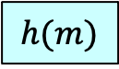


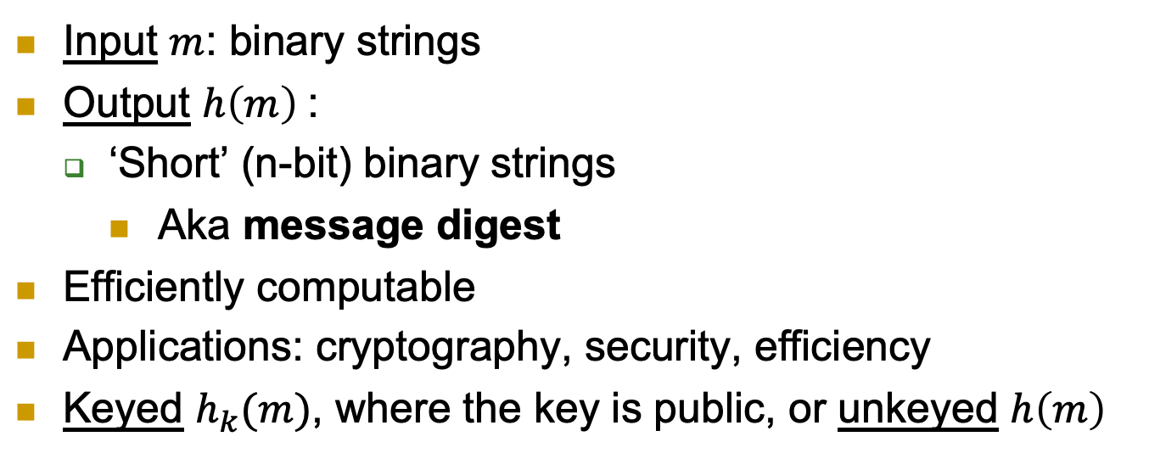
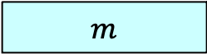
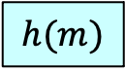

Hash Functions
Input $m$: binary strings
Output $h\left(m\right)$:
‘Short’ (n-bit) binary strings
Aka message digest
Efficiently computable
Applications: cryptography, security, efficiency
Keyed $h_{k}(m)$, where the key is public, or unkeyed $h\left(m\right)$
$$m$$
$$m$$
k
$$h$$
$$h$$
$$h(m)$$
$$h(m)$$

Slide 4

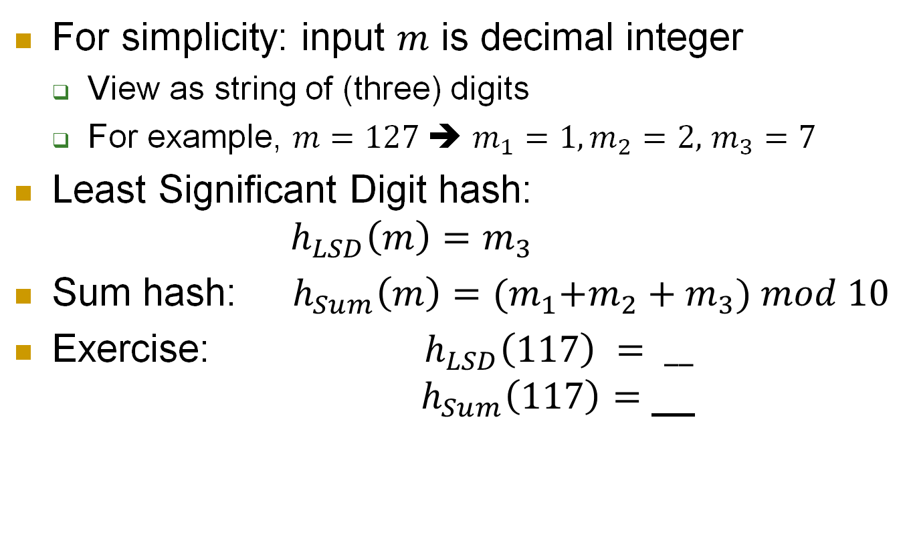
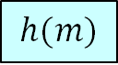

Hash functions: simple examples
$$m$$
$$h$$
For simplicity: input $m$ is decimal integer
View as string of (three) digits
For example, $m=127$➔ $m_{1}=1,m_{2}=2,$ $m_{3}=7$
Least Significant Digit hash: $h_{LSD}\left(m\right)=m_{3}$
Sum hash: $h_{Sum}\left(m\right)={{(m}_{1}+m_{2}+m}_{3}) mod 10$
Exercise: ${ h}_{LSD}\left(117\right) {= __}_{}$ $h_{Sum}\left(117\right)=$ __
$$h(m)$$
7
9
Note: the above are insecure hash functions, these are just toy examples to grasp the concept of hashing.

Slide 5


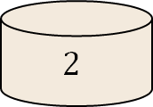

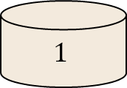
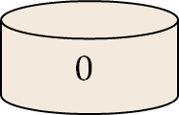
Motivation: Hashing for efficiency
Input: large set (e.g., integers or strings)
Goal: map `randomly’ to few bins
E.g., to ensure efficiency – load balancing, etc.
341,
3342,
870,
571,
31,
452,
80,
….
$$h_{LSD}$$
341,
571,
31,
….
3342,
452,
….
870,
80,
….
. . .
$$1$$
$$2$$
. . .
$$0$$

Slide 6


Collisions?
Input: large set (e.g., integers or strings)
Goal: map `randomly’ to few bins
E.g., to ensure efficiency – load balancing, etc.
Adversary chooses inputs that hash to same bin
32,
42,
52,
62,
31,
452,
80,
….
$$h_{LSD}$$
Inputs to overload the `2’ bin
31,
….
32, 42,
52, 62,
452,
….
80,
….
. . .
$$1$$
$$2$$
. . .
$$0$$
Denial-of-Service
Attack

Slide 7


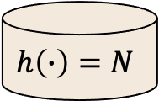
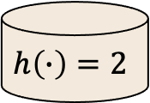
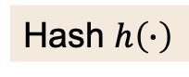
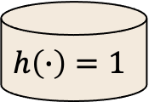
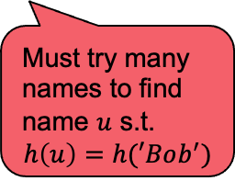
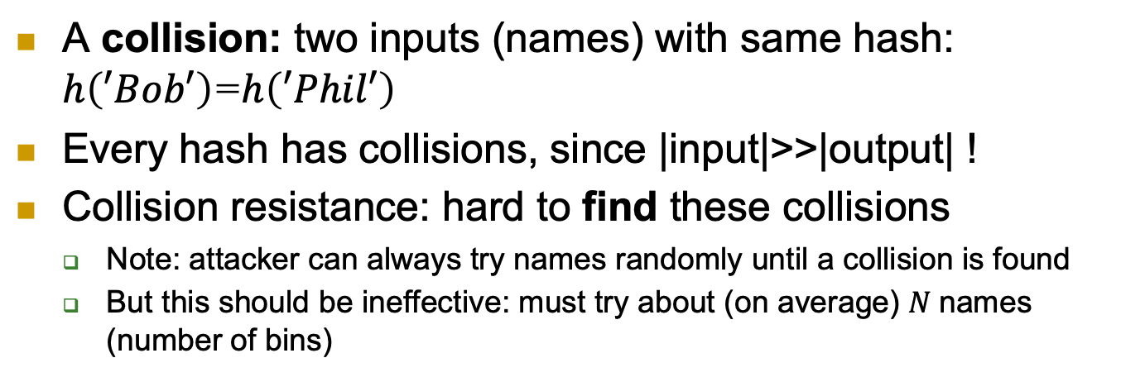
Security Goal: Collision Resistance
A collision: two inputs (names) with same hash: $h\left(′Bob′\right)$=$h\left(′Phil′\right)$
Every hash has collisions, since |input|>>|output| !
Collision resistance: hard to find these collisions
Note: attacker can always try names randomly until a collision is found
But this should be ineffective: must try about (on average) $N$names (number of bins)
Mal
Abe
Don
Phil
Ron
John
Sue
Bob
….
Hash $h\left(∙\right)$
Must try many names to find name $u$ s.t. $$h\left(u\right)=h(′Bob^{′})$$
Phil, Bob, …
$$h\left(∙\right)=1$$
$$h\left(∙\right)=2$$
. . .
$$h\left(∙\right)=N$$

Slide 8
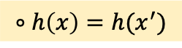
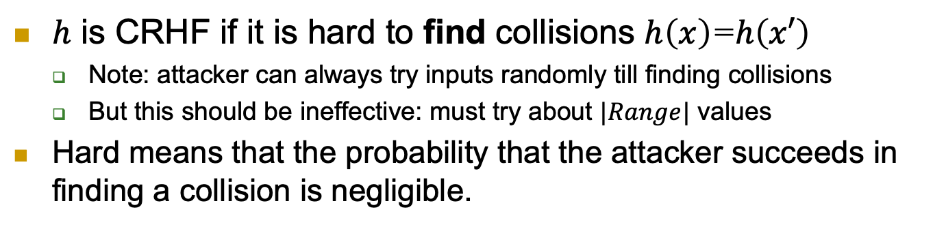
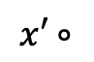

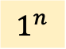
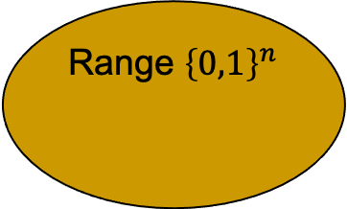
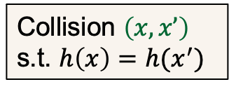
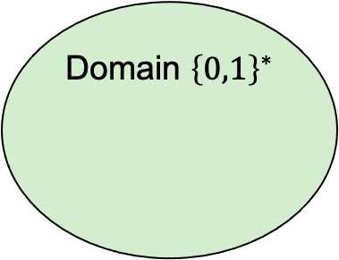
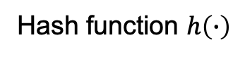
Collision Resistant Hash Function (CRHF)
$h$ is CRHF if it is hard to find collisions $h\left(x\right)$=$h\left(x′\right)$
Note: attacker can always try inputs randomly till finding collisions
But this should be ineffective: must try about $|Range|$ values
Hard means that the probability that the attacker succeeds in finding a collision is negligible.
$$1^{n}$$
Domain ${\left\{0,1\right\}}^{∗}$
Hash function $h\left(∙\right)$
Range ${\left\{0,1\right\}}^{n}$
Adversary
$$x∘$$
Collision $\left(x,x’\right)$
s.t. $h\left(x\right)=h(x^{′})$
$$x′∘$$
$$∘h\left(x\right)=h(x^{′})$$

Slide 9
Collision Resistant Hash Function (CRHF)
$h$ is CRHF if it is hard to find collisions $h\left(x\right)$=$h\left(x′\right)$
Note: attacker can always try inputs randomly till finding collisions
But this should be ineffective: must try about $|Range|$ values
Hard means that the probability that the attacker succeeds in finding a collision is negligible.

Slide 10
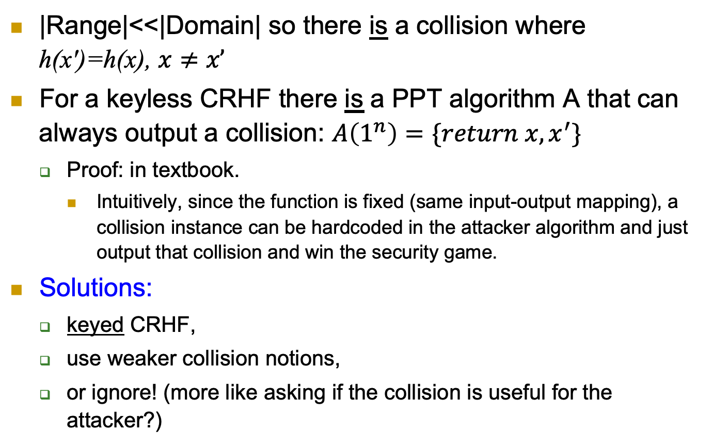
Keyless CRHF Do Not Exist!
|Range|<<|Domain| so there is a collision where h(x')=h(x), $x≠x’$
For a keyless CRHF there is a PPT algorithm A that can always output a collision: $A\left(1^{n}\right)=\{return x, x^{′}\}$
Proof: in textbook.
Intuitively, since the function is fixed (same input-output mapping), a collision instance can be hardcoded in the attacker algorithm and just output that collision and win the security game.
Solutions:
keyed CRHF,
use weaker collision notions,
or ignore! (more like asking if the collision is useful for the attacker?)

Slide 11

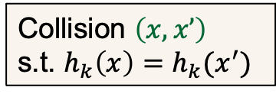

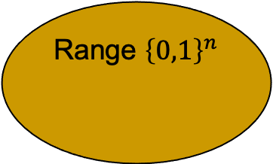
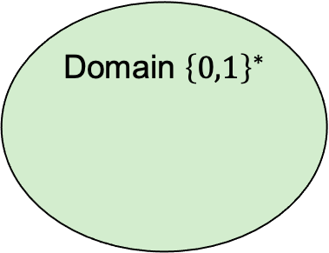
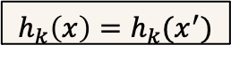
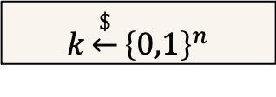
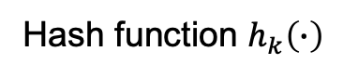
Keyed CRHF
$$k\underset{←}{\$}{\left\{0,1\right\}}^{n}$$
Domain ${\left\{0,1\right\}}^{∗}$
Hash function $h_{k}\left(∙\right)$
Range ${\left\{0,1\right\}}^{n}$
Adversary
$$x∘$$
$$x′∘$$
$$h_{k}\left(x\right)=h_{k}(x^{′})$$
Collision $\left(x,x’\right)$
s.t. $h_{k}\left(x\right)=h_{k}(x^{′})$
Adversary knows k but not in advance – cannot `know` a collision
Often referred to as ACR-hash (ANY-collision resistance)
Notes:
11
(c) Amir Herzberg, http://AmirHerzberg.com, Bar Ilan University
04/07/06

Slide 12
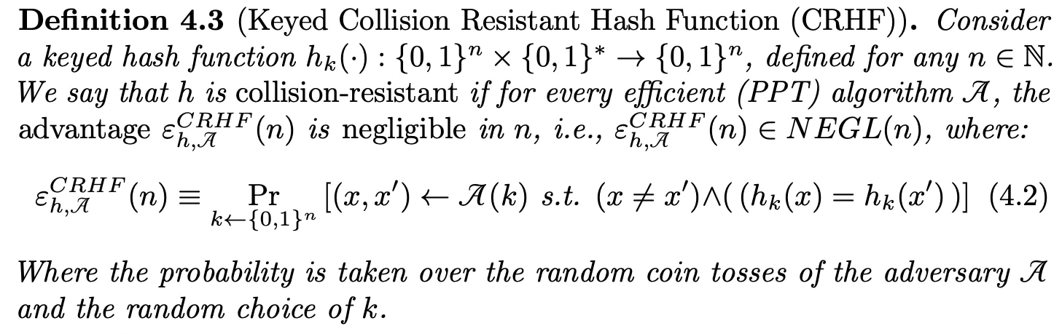
Keyed CRHF - Definition
Notes:
12
(c) Amir Herzberg, http://AmirHerzberg.com, Bar Ilan University
04/07/06

Slide 13
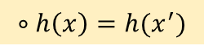
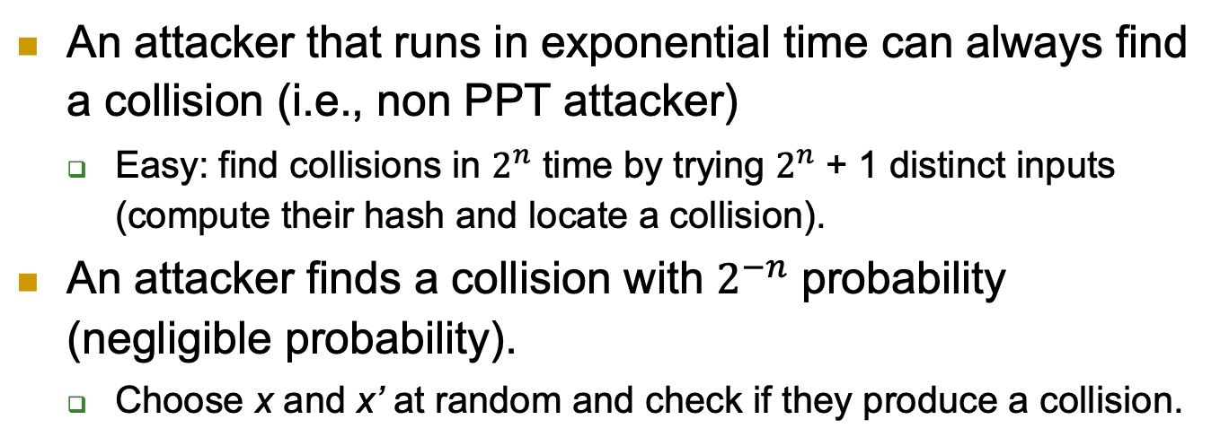


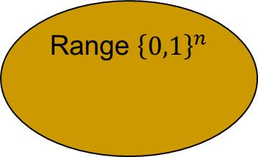
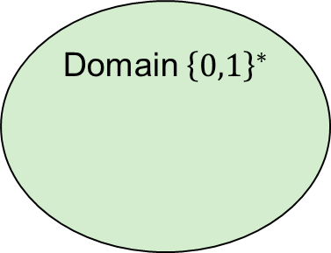
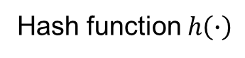
Generic Collision Attacks
Domain ${\left\{0,1\right\}}^{∗}$
Hash function $h\left(∙\right)$
Range ${\left\{0,1\right\}}^{n}$
$$x∘$$
$$x′∘$$
$$∘h\left(x\right)=h(x^{′})$$
An attacker that runs in exponential time can always find a collision (i.e., non PPT attacker)
Easy: find collisions in $2^{n}$ time by trying $2^{n}$ + 1 distinct inputs (compute their hash and locate a collision).
An attacker finds a collision with $2^{−n}$ probability (negligible probability).
Choose x and x’ at random and check if they produce a collision.
Notes:
13
(c) Amir Herzberg, http://AmirHerzberg.com, Bar Ilan University
04/07/06
CR>SPR [and SPR<OWF if |domain|>>|range|
Which property is required for signatures? For deriving DH/El-gamal keys?

Slide 14
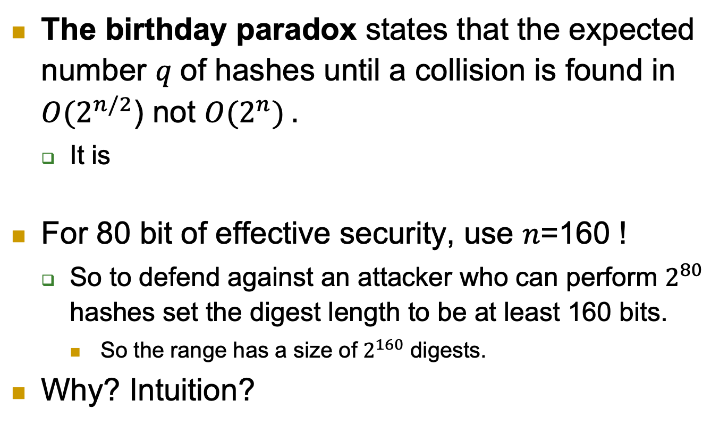
The Birthday Paradox
The birthday paradox states that the expected number 𝑞 of hashes until a collision is found in $O(2^{n/2}$) not ${O(2}^{n}) .$
It is
For 80 bit of effective security, use 𝑛=160 !
So to defend against an attacker who can perform $2^{80}$ hashes set the digest length to be at least 160 bits.
So the range has a size of $2^{160}$ digests.
Why? Intuition?
Notes:
14
(c) Amir Herzberg, http://AmirHerzberg.com, Bar Ilan University
04/07/06
CR>SPR [and SPR<OWF if |domain|>>|range|
Which property is required for signatures? For deriving DH/El-gamal keys?

Slide 15
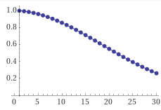






The Birthday Attack (‘Paradox’)
Probability of NO birthday-collision:
Two persons: (364/365)
Three persons: (364/365)*(363/365)
…
$n$ persons: $\prod_{i=1}^{n−1}{\frac{365−i}{365}}$
So for 23 individuals, the probability
of birthday collision is about 0.5
Jan | Feb | Mar | Apr | May | Jun | Jul | Aug | Sep | Oct | Nov | Dec

Slide 16
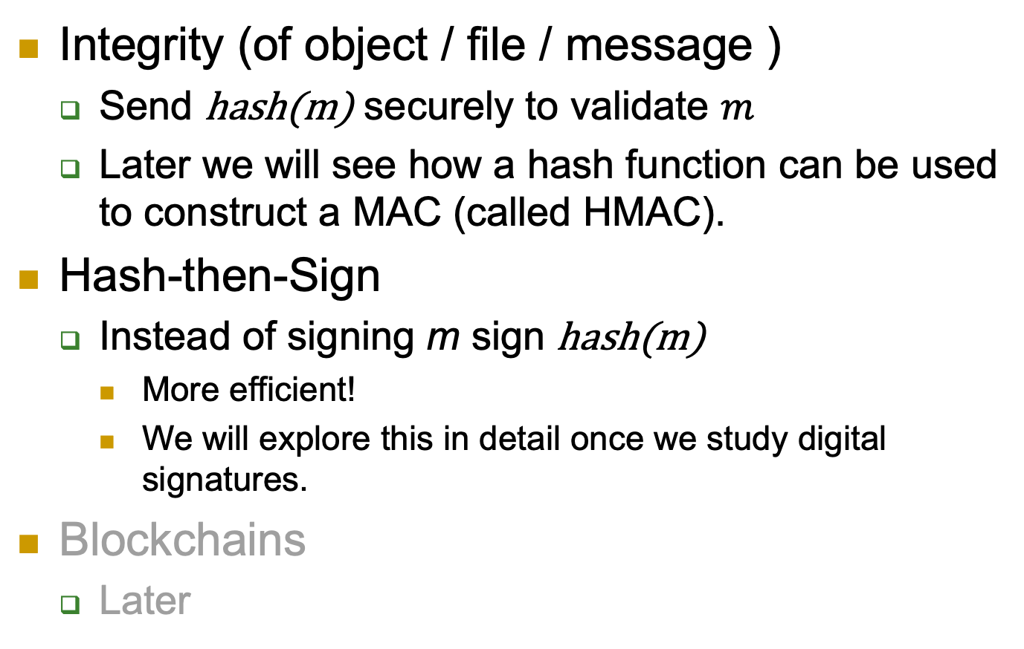
Collision-Resistance: Applications
Integrity (of object / file / message )
Send hash(m) securely to validate $m$
Later we will see how a hash function can be used to construct a MAC (called HMAC).
Hash-then-Sign
Instead of signing m sign hash(m)
More efficient!
We will explore this in detail once we study digital signatures.
Blockchains
Later

Slide 17



CRHF and Software Distribution
Developer in LA develops a large software $m$
Repository in DC obtains a copy of $m$
User in NY wants to obtain $m$ – securely and efficiently
Don’t send $m$from LA to both NY and DC
How?
NY
User
DC
LA
$$m$$
Repository
Developer

Slide 18






CRHF: secure, efficient SW distribution
1. Repository in DC downloads software $m$ from developer in LA
2. User downloads from (nearby) repository; receives $m’$
Is $m’=m$? User should validate! How?
3. User securely downloads $h(m)$directly from developer
Digest $h(m)$ is short – much less overhead than downloading m
4. User validates: $h\left(m\right)=h\left(m’\right)$➔$m=m’$
NY
User
NY
3
$$h(m)$$
2
$$m′$$
DC
$$m$$
DC
$$h$$
LA
Repository
LA
1
$$m$$
$$m$$
$$h(m)$$
Developer

Slide 19
Weaker Notions of Security
Collision resistance provides the strongest guarantee.
Gives more freedom to the adversary; the adversary wins if it finds any two inputs with the same digest.
No conditions on these two inputs other than being in the domain of the hash function.
Weaker security notions (but sufficient for many applications):
Target collision resistance (TCR).
Second preimage resistance.
First preimage resistance.
Birthday paradox (or attack) does not work against these weaker notions.
It is for collision resistance; find any two inputs that collide!

Slide 20








Target CRHF (TCR Hash Function)
$$1^{n}$$
Adversary
Domain ${\left\{0,1\right\}}^{∗}$
Hash function $h_{k}\left(∙\right)$
Range ${\left\{0,1\right\}}^{n}$
$$k\underset{←}{\$}{\left\{0,1\right\}}^{n}$$
x
$$x∘$$
Adversary
$$x′∘$$
$$h_{k}\left(x\right)=h_{k}(x^{′})$$
Collision: $x^{′}$ s.t. $h_{k}\left(x\right)=h_{k}(x^{′})$
Adversary has to select target before knowing key
Notes:
20
(c) Amir Herzberg, http://AmirHerzberg.com, Bar Ilan University
04/07/06

Slide 21





TCR and Birthday Paradox?
First: adversary selects x
Probability for NO birthday-collision with x:
Two persons: (364/365)
Three persons: (364/365)*(364/365)
…
$n$ persons: $\prod_{i=1}^{n−1}{\frac{364}{365}=}{\left(\frac{364}{365}\right)}^{n−1}$
$$1^{n}$$
Adversary
$$k\underset{←}{\$}{\left\{0,1\right\}}^{n}$$
x
Adversary
Collision: $x^{′}$ s.t. $h_{k}\left(x\right)=h_{k}(x^{′})$
Jan | Feb | Mar | Apr | May | Jun | Jul | Aug | Sep | Oct | Nov | Dec

Slide 22
We (mostly) focus on keyless hash…
Although there are no CRHFs
And theory papers focus on keyed hash
But…
It’s a bit less complicated and easier to work with.
No need to consider both ACR (this stands for Any Collision Resistance, which is the same as CRHF) and TCR
Why?
Modifying to CRHF is quite trivial
Just make it keyed!
Usually used in practice: libraries, standards, …

Slide 23








2nd-Preimage-Resistant Hash (SPR)
Hard to find collision with a specific random x.
$$x\underset{←}{\$}{\left\{0,1\right\}}^{l}$$
Domain ${\left\{0,1\right\}}^{∗}$
Hash function $h\left(∙\right)$
Range ${\left\{0,1\right\}}^{n}$
Adversary
First preimage
$$x∘$$
Second preimage
$$x′∘$$
$$∘h\left(x\right)=h(x^{′})$$
$x’$ s.t. $x′≠x$
Use with care!
(think carefully about the security you want to achieve and see if SPR suffices)
Notes:
23
(c) Amir Herzberg, http://AmirHerzberg.com, Bar Ilan University
04/07/06

Slide 24


CRHF/SPR vs. Applications
CRHF secure for signing, SW-distribution
How about SPR hash (weak-CRHF)?
SW-distribution? YES
Hash-then-sign? NO
Why?
Attacker can’t impact SW to be distributed
But… attacker may be able to impact signed msg!
Will/Contract/…
Sign(h(Will/Contract/…))

Slide 25


SPR: Collisions to Chosen Messages
Or: Alice and Mal, the corrupt lawyer
Mal finds two `colliding wills’, GoodW and BadW:
GoodW: contents agreeable to Alice
h(GoodW)=h(BadW)
Alice Signs good will: Sign(h(GoodW))
Later… Mal presents to the court:
h(GoodP)=h(BadP)
GoodW: ‘I leave all to Bob’
Sign_{A}(h(GoodW))
BadW: ‘I leave all to Mal’, Sign_{A}(h(BadW))
$$$$

Slide 26
SPR: collisions to chosen message
Or: Alice and Mal, the corrupt lawyer
Mal finds two `colliding wills’, GoodW and BadW:
GoodW: contents agreeable to Alice
h(GoodW)=h(BadW)
Alice Signs good will: Sign_{A}(h(GoodW))
Later… Mal presents to the court:
Is such attack realistic? Or SPR is enough ‘in practice’?
h(GoodP)=h(BadP)
GoodW: ‘I leave all to Bob’
Sign_{A}(h(GoodW))
BadW: ‘I leave all to Mal’, Sign_{A}(h(BadW))
$$$$

Slide 27

SPR & Chosen-prefix Vulnerability
Chosen-prefix vulnerability:
Mal selects `prefix string’ $p$
Efficient algorithm finds:
$x≠x^{′}$ s.t. $h(p|\left|x\right)=h(p||x′)$
Or, also for any suffix: $\left(∀s\right)h(p|\left|x||s\right)=h(p|\left|x^{′}\right||s)$
Hash may be SPR yet allow chosen-prefix attacks
Such attacks found for several proposed, standard cryptographic hash function, e.g., MD5 and SHA1
We show chosen prefix attack on HtS
Example of possible attack on HtS with SPR
Notes:
27
(c) Amir Herzberg, http://AmirHerzberg.com, Bar Ilan University
04/07/06

Slide 28

Chosen-prefix Attack
Let $x<x^{′}$ be collision for prefix: p=`Pay Mal $’
Mal tricks Alice into signing him an IOU for $$x$
Alice signs, sends s=$S_{s}^{h}$(m) where m= `Pay Mal $’||$x$
$S_{s}^{h}$(m)=$S_{s}$(h(p||x))=$S_{s}$(h(p||x’))=$S_{s}^{h}$(m’)
m’= `Pay Mal $’||$x′$
Mal sends s, m’ to Alice’s bank
Bank validates “Ok”=Verify_{Alice.v}(m’,s)
Bank gives $$x′$ of Alice to Mal!!
This attack is simplified:
Mal has to find `good’ collision (high profit, convince Alice to sign)
People sign (PDF) files, not plain text…
In reality, attacker also chooses suffix ➔ stronger attack

Slide 29
Examples
1) Let h_{k} be a keyed CRHF. Is h_{k}’ = h_{k}(h_{k}(x)) a CRHF? Why?
2) For x parsed as x = x₁||x₂||x_{3 ,} let h(x₁||x₂||x₃) = x₁ + x₂ + x₃ mod p, is h a CRHF? Why? Is it an SPR? Why?
3) Let h_{k}(m) be a TCR function. Construct h_{k}’(m) = 0^{n} if m[1: |k|] = k and h_{k}(m) otherwise (recall m, the hash function input, can be of any length).
Is h_{k}’ a CRHF? Why?
Is h_{k}’ a TCR? Why?

Slide 32










One-Way Function (OWF)
$h\left(x\right)$ (for random $x$)
Domain ${\left\{0,1\right\}}^{∗}$
Hash function $h\left(∙\right)$
Range ${\left\{0,1\right\}}^{n}$
Adversary
$$x∘$$
$$x′∘$$
$$∘h\left(x\right)=h(x^{′})$$
$x’$ (or $x$)
Hard
One-way function or first preimage resistance: given h(x) for a random x, it is hard to find x, or any x' s.t. h(x')=h(x)
Compare to:
Collision-Resistance (CRHF): hard to find any collision, i.e., any $\left(x,x’\right)$ s.t. h(x')=h(x), $x≠x’$
Second-preimage resistance (SPR): hard to find a collision with random $x$, i.e.,$x’$ s.t. h(x')=h(x), $x≠x’$
Note: the textbook has a typo in formula 3.17, page 201. The attacker A takes h(x) as input not x.
Notes:
32
(c) Amir Herzberg, http://AmirHerzberg.com, Bar Ilan University
04/07/06

Slide 33

Application: One-time Password Authentication
$h\left(x\right)$ (for random $x$)
Domain ${\left\{0,1\right\}}^{∗}$
Hash function $h\left(∙\right)$
Range ${\left\{0,1\right\}}^{n}$
Adversary
$$x∘$$
$$x′∘$$
$$∘h\left(x\right)=h(x^{′})$$
$x’$ (or $x$)
Hard
One-time password authentication:
Select random x : ‘one-time password’ (keep secret!)
Validate using non-secret ‘one-time validation token’: h(x)
How about a one-time password chain?
Notes:
33
(c) Amir Herzberg, http://AmirHerzberg.com, Bar Ilan University
04/07/06

Slide 34

Not an Application: One-time Password Chain
Alice computes a hash chain instead of one hash:
Select random $x_{0}$ then compute a chain of length $l$ of hashes: $x_{i+1}=h(x_{i})$
This allows Alice to authenticate $l$ times instead of one.
Alice gives the server $x_{l}$ then each time she wants to authenticate she sends $x_{i−1}$
The server can check by verifying that $x_{i}=h(x_{i−1})$
A one-way function property alone may not be sufficient, $h$ has also to be a permutation.
$x_{i}$ need to be uniformly distributed.
Notes:
34
(c) Amir Herzberg, http://AmirHerzberg.com, Bar Ilan University
04/07/06

Slide 35
Example
Let h(x) be a OWF, construct g(x) as:
g(x) = 0^{2n} if x mod 2^{n} = 0
g(x) = h(x) || 0^{n} otherwise
g(x) is a OWF.
Why?
But f(x) = g(g(x)) is not a OWF.
Why?
And recall that a one time password chain is a nested calls of the hash function.
So g(x) cannot be used to construct such a chain.
Why?
Notes:
35
(c) Amir Herzberg, http://AmirHerzberg.com, Bar Ilan University
04/07/06

Slide 37
Exercise
Let h₁, h₂ be both CRHF and OWF
Use them to construct:
h_{CRHF} - CRHF but not OWF
h_{OWF} - OWF but not CRHF

Slide 38

Exercise
Let h₁, h₂ be both CRHF and OWF
Use them to construct:
h_{CRHF} - CRHF but not OWF
h_{OWF} - OWF but not CRHF
One possible solution:
$h_{CRHF}\left(m\right)=\left\{\begin{aligned}1 ||m if \left|m\right|=n \\ \text{0||}\text{h}\text{1}\text{(}\text{m}\text{) } \text{otherwise}\end{aligned}\right.$
$h_{OWF}\left(m\right)=\left\{\begin{aligned}h_{1}\left(m\right) if \left|m\right|=n \\ h_{1}\left({m_{1..n}⨁h}_{2}\left(m′\right)\right) if m=m_{1..n}||m′\end{aligned}\right.$

Slide 40
What does all of that tell you about …
… the relation between CRHF, SPR, and OWF?
CRHF vs. SPR?
CRHF vs. OWF?
SPR vs. OWF?

Slide 41





Randomness Extraction
Select random bit $b\underset{←}{\$}\{0,1\}$
$y_{b}=h(x$)
$y_{b−1}\underset{←}{\$}{\{0,1\}}^{n}$ (random)
$$\left(y_{0},y_{1}\right)$$
Let $x$be string chosen by adversary, except for $m$ random bits
Adv
Guess $b’$;
Adv wins if $b^{′}=b$
‘If input is sufficiently random, then output is random’
Multiple `sufficiently random’ models
Randomness extraction: if any $m$ input bits are random ➔ all $n$ output bits are pseudorandom
For sufficiently large$m$
Pseudorandom: it is not computationally-feasible to distinguish between these bits and truly random bits
Notes:
41
(c) Amir Herzberg, http://AmirHerzberg.com, Bar Ilan University
04/07/06

Slide 42
Random Oracle Model (ROM)
Use a fixed, keyless hash function h
Analyse security as if hash h() is a random function
An invalid assumption: h() is fixed!
Whenever h() is used, use oracle (black box) for random function
Good for screening insecure solutions
Random oracle security ➔ many attacks fail
In practice: assume random oracle and use a standard hash function
It was shown that in some cases the construction will become insecure.
Better to have security with standard assumption than the non-standard ROM.
Notes:
42
(c) Amir Herzberg, http://AmirHerzberg.com, Bar Ilan University
04/07/06

Slide 43
Covered Material From the Textbook
Chapter 3
Section 3.1,
Section 3.2 (except 3.2.6 and 3.2.7),
Section 3.3,
Section 3.4 (except 3.4.2),
Section 3.5 (only its introduction, i.e., all text before 3.5.1),
Section 3.6

Slide 44

Thank You!

